Slide 1

Discovering Patterns in Global Temperature Anomalies
Leveraging Order-Preserving Motifs (OPM) & Cartesian Tree Matching (CTM)
Presented by: Yoni Grinberg & Yuval Shahar
Our study delves into the Berkeley Earth Global Temperature Anomalies dataset, utilizing advanced pattern recognition techniques to uncover significant climatic trends.

Slide 2
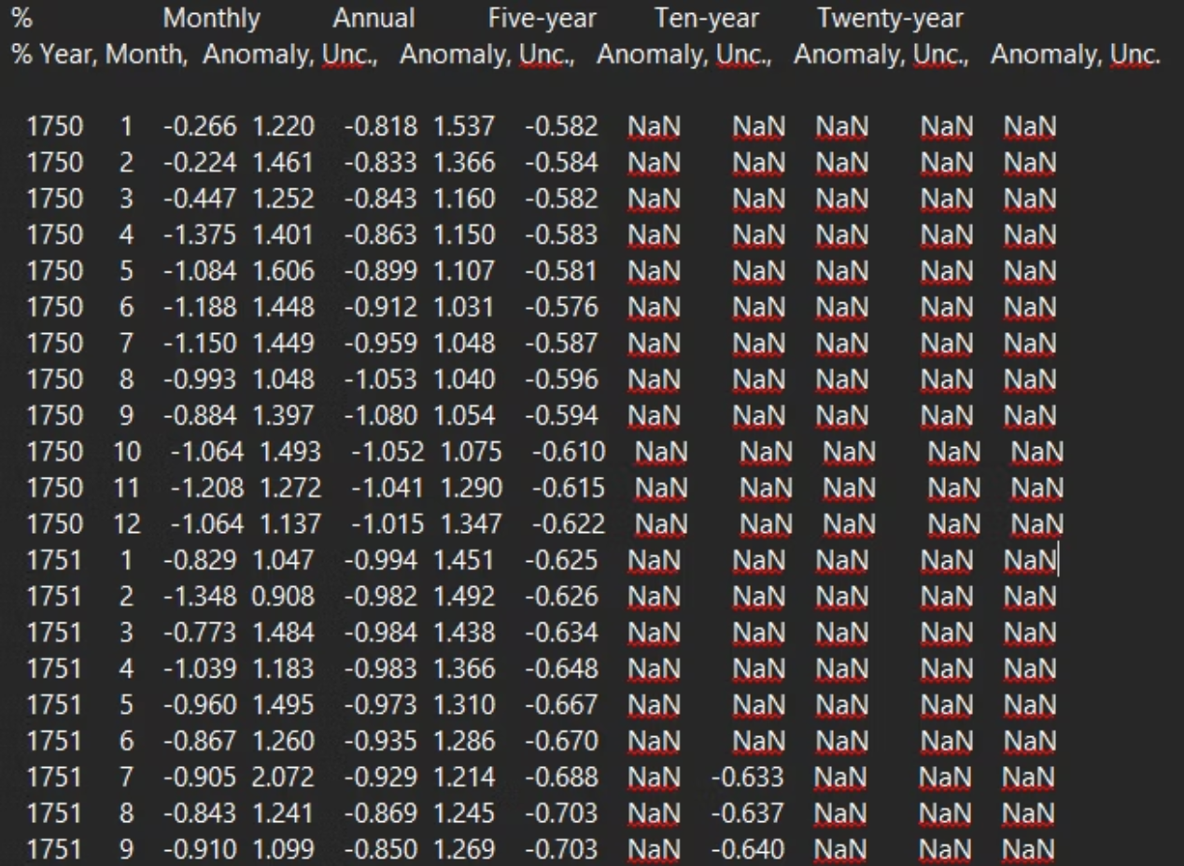
The Dataset: Berkeley Earth High-Resolution Land-Only Average
We utilized the Berkeley Earth dataset, a comprehensive record of land-only temperature averages. This high-resolution data provides crucial insights into global temperature shifts, forming the foundation of our analysis.
Global land temperature anomalies
High-resolution monthly data
Extensive historical coverage
Essential for climate pattern discovery

Slide 3

The Challenge: Beyond Raw Values
Analyzing climate data presents a unique challenge: raw temperature values rarely repeat exactly. This makes identifying meaningful "shapes" and "trends" exceptionally difficult when relying solely on numerical similarity.
1
2
The Problem: Numerical Volatility
The Need: Shape and Trend Recognition
Exact temperature values are subject to constant fluctuations, obscuring underlying patterns.
We require methods that can identify recurring forms and directional shifts, not just identical numbers.
3
The Solution: OPM & CTM
Order-Preserving Motifs and Cartesian Tree Matching provide powerful tools for abstracting data into recognizable patterns.

Slide 4





Order-Preserving Motifs (OPM)
OPM allows us to analyze the relative rank of data points, rather than their absolute values. This provides a robust way to discover recurring "shapes" in time-series data, even when magnitudes differ.
Data Discretization
Transform raw values into their relative ranks or orderings.
Subsequence Extraction
Identify all subsequences of a specified length within the time series.
Pattern Comparison
Compare subsequences based on their order-preserving similarity.
Motif Discovery
Group similar subsequences to identify frequently occurring motifs.

Slide 5

Cartesian Tree Matching (CTM)
CTM represents time-series data as a geometric tree structure, capturing hierarchical relationships and local extrema. This approach allows for efficient and intuitive pattern discovery.
01
02
Cartesian Tree Construction
Tree Representation
Build a Cartesian tree where each node represents a data point and its parent is the nearest larger/smaller value.
The tree structure encodes the "shape" of the time series, highlighting peaks and troughs.
03
04
Subtree Matching
Pattern Identification
Search for recurring subtrees, which correspond to similar patterns in the original data.
Identify frequent and significant subtrees as key patterns or motifs.

Slide 6


Comparing OPM and CTM
Both OPM and CTM offer distinct advantages in time-series pattern mining, providing complementary perspectives on climate data trends.
OPM Strengths
CTM Strengths
Focuses on relative order, robust to scaling and shifting.
Captures hierarchical structure and local extrema efficiently.
Effective for identifying "shapes" independent of magnitude.
Excellent for identifying patterns based on peaks, valleys, and turning points.
Good for discovering subtle shifts in trends.
Provides a geometric interpretation of data structure.

Slide 7

Top 10 CTM & OPM Motifs in Global Temperature

Slide 8

Structure of Significant CTM Tree Patterns

Slide 9
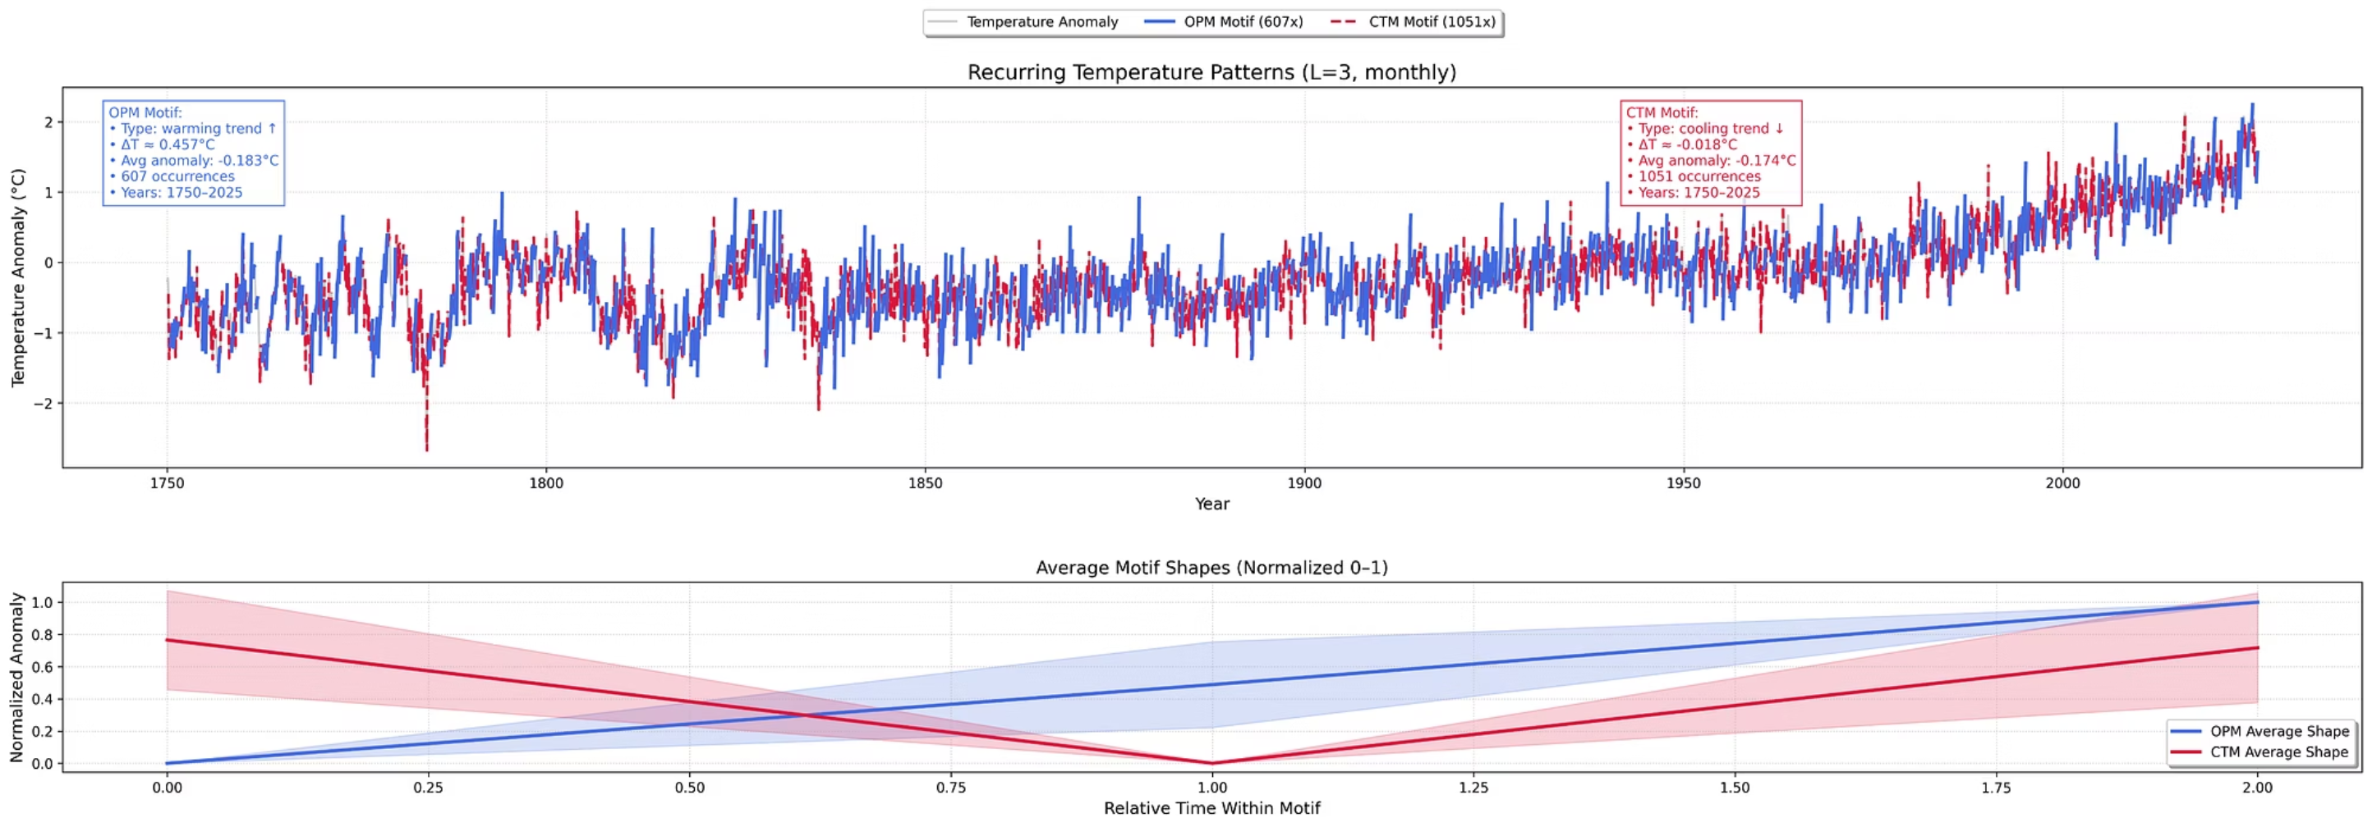
OPM & CTM: Parameterizing Motif Length (L)
The parameter 'L' represents the number of consecutive months analyzed, directly impacting the granularity of discovered motifs. This is crucial for capturing both short-term fluctuations and longer-term trends.
L
Length of the motif (number of consecutive months).
Data Points
Monthly temperature anomaly values.

Slide 10
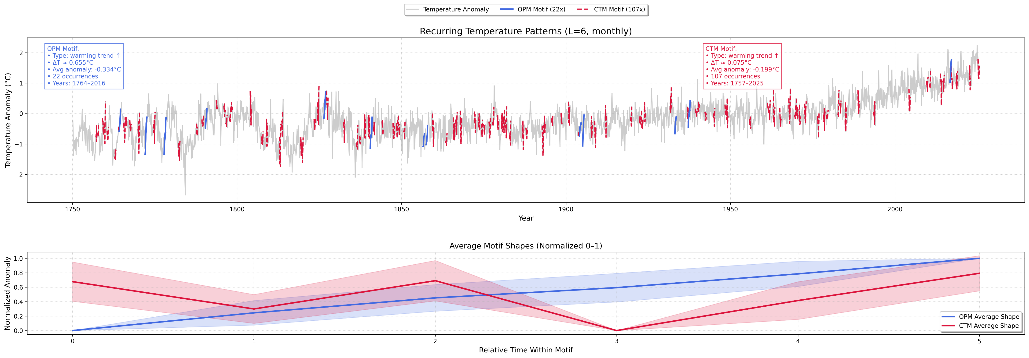
OPM & CTM: Parameterizing Motif Length (L)

Slide 11
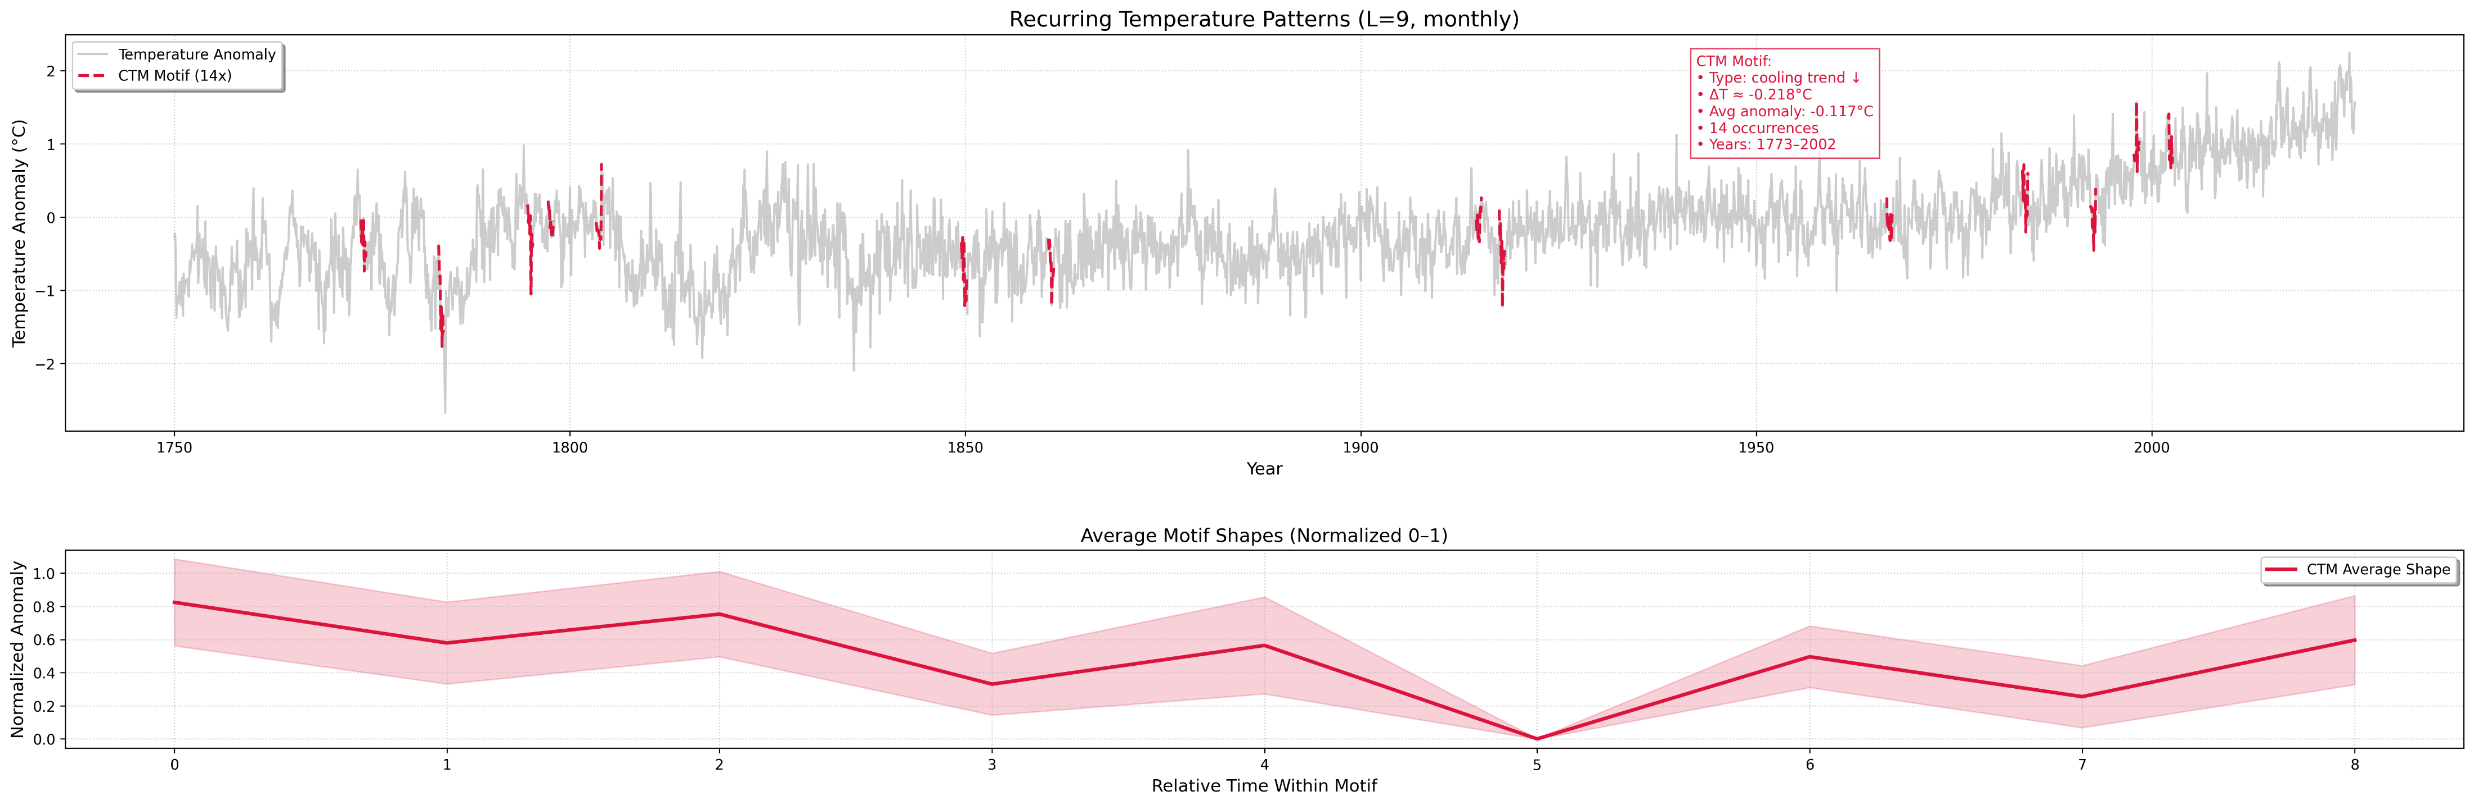
OPM & CTM: Parameterizing Motif Length (L)

Slide 12
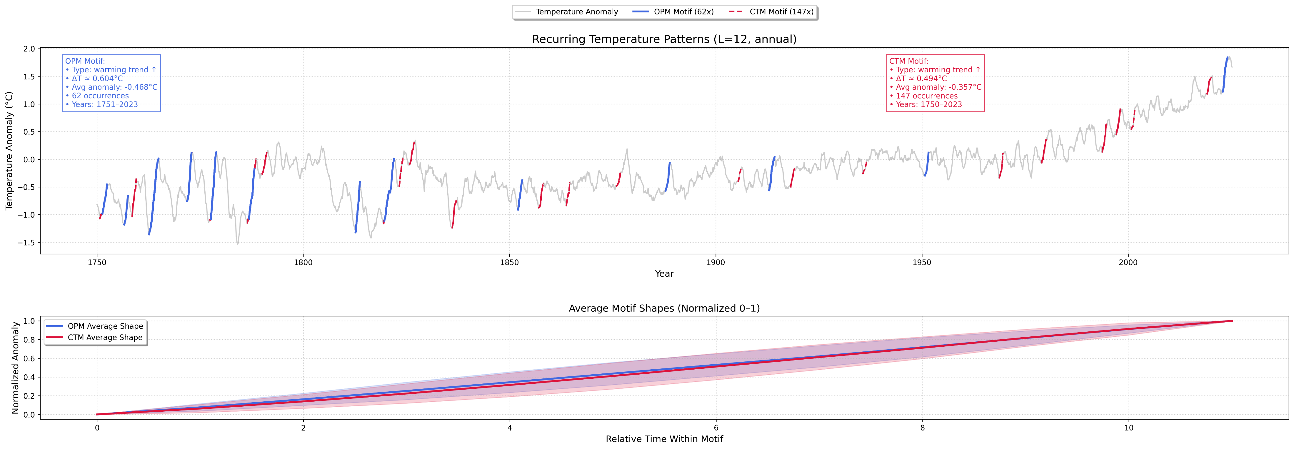
OPM & CTM: Parameterizing Motif Length (L)

Slide 13
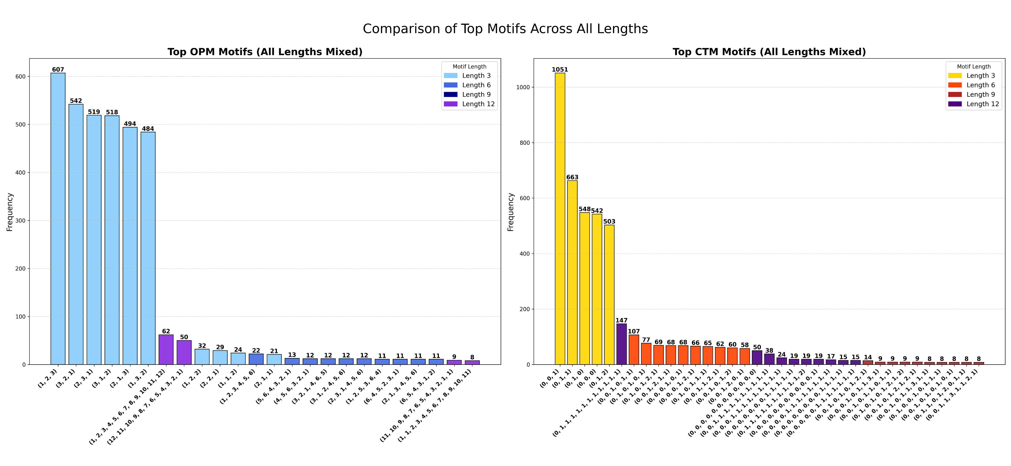

Slide 14
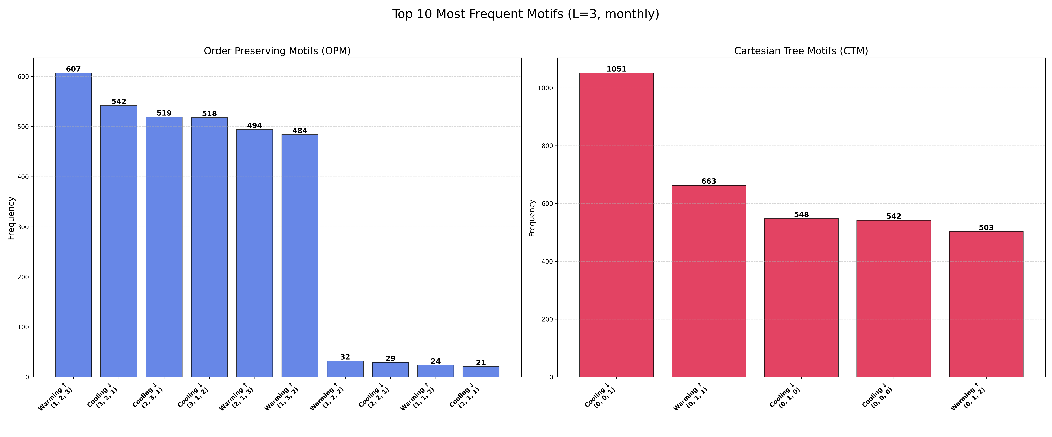
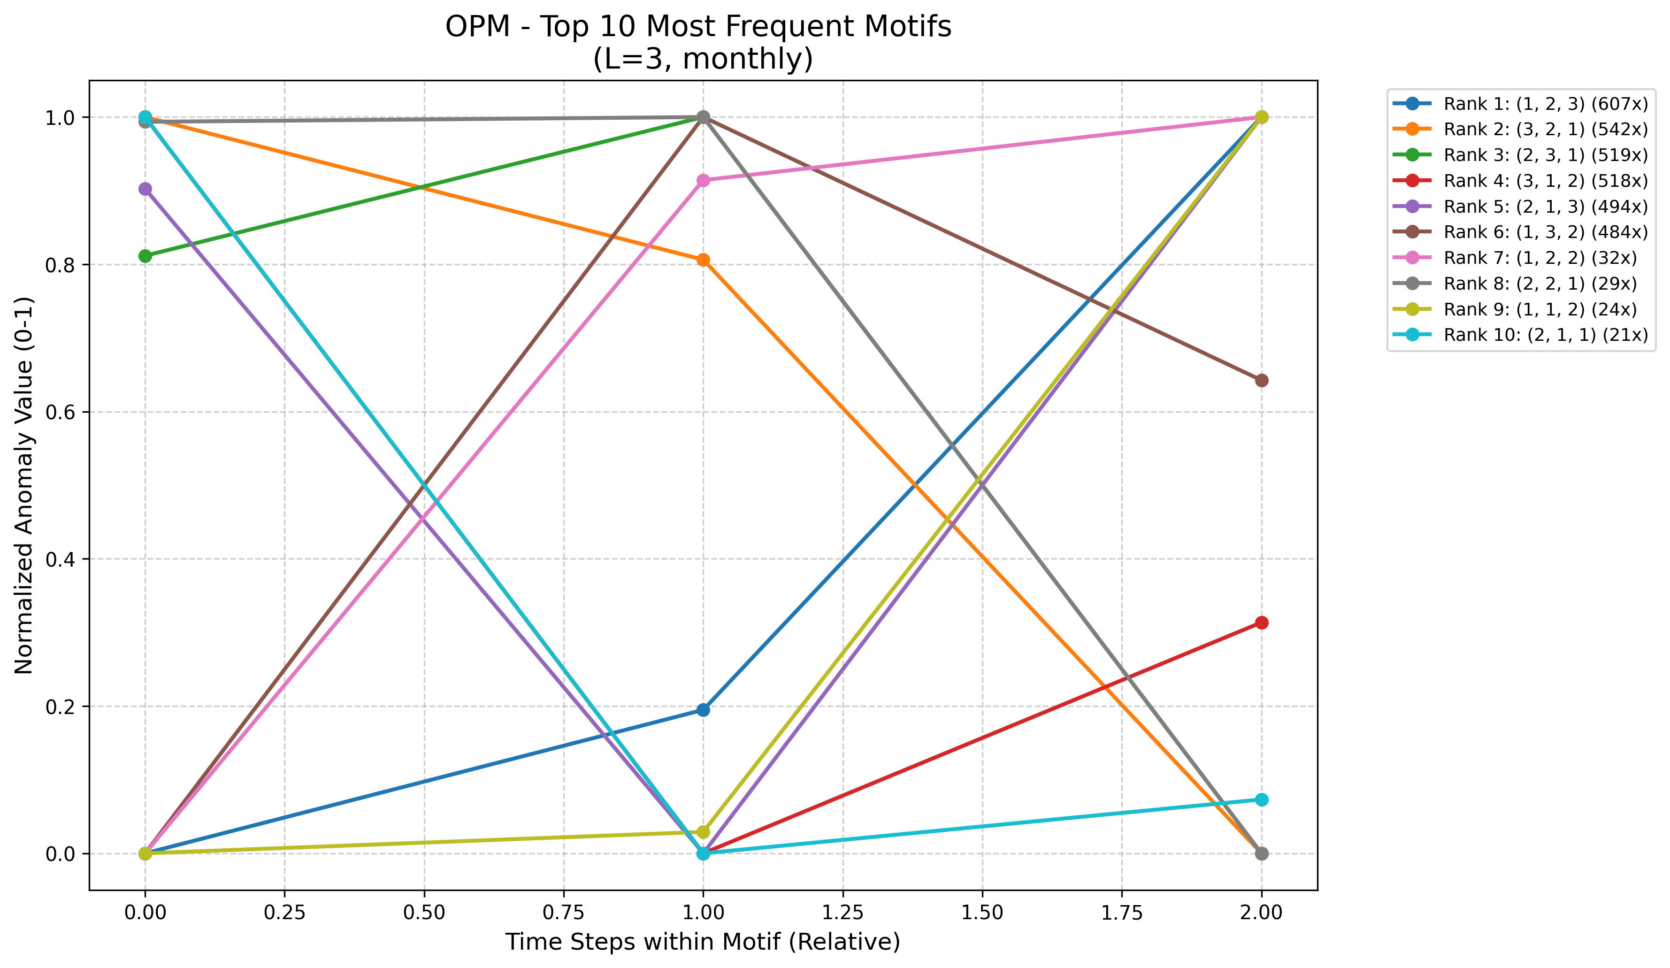
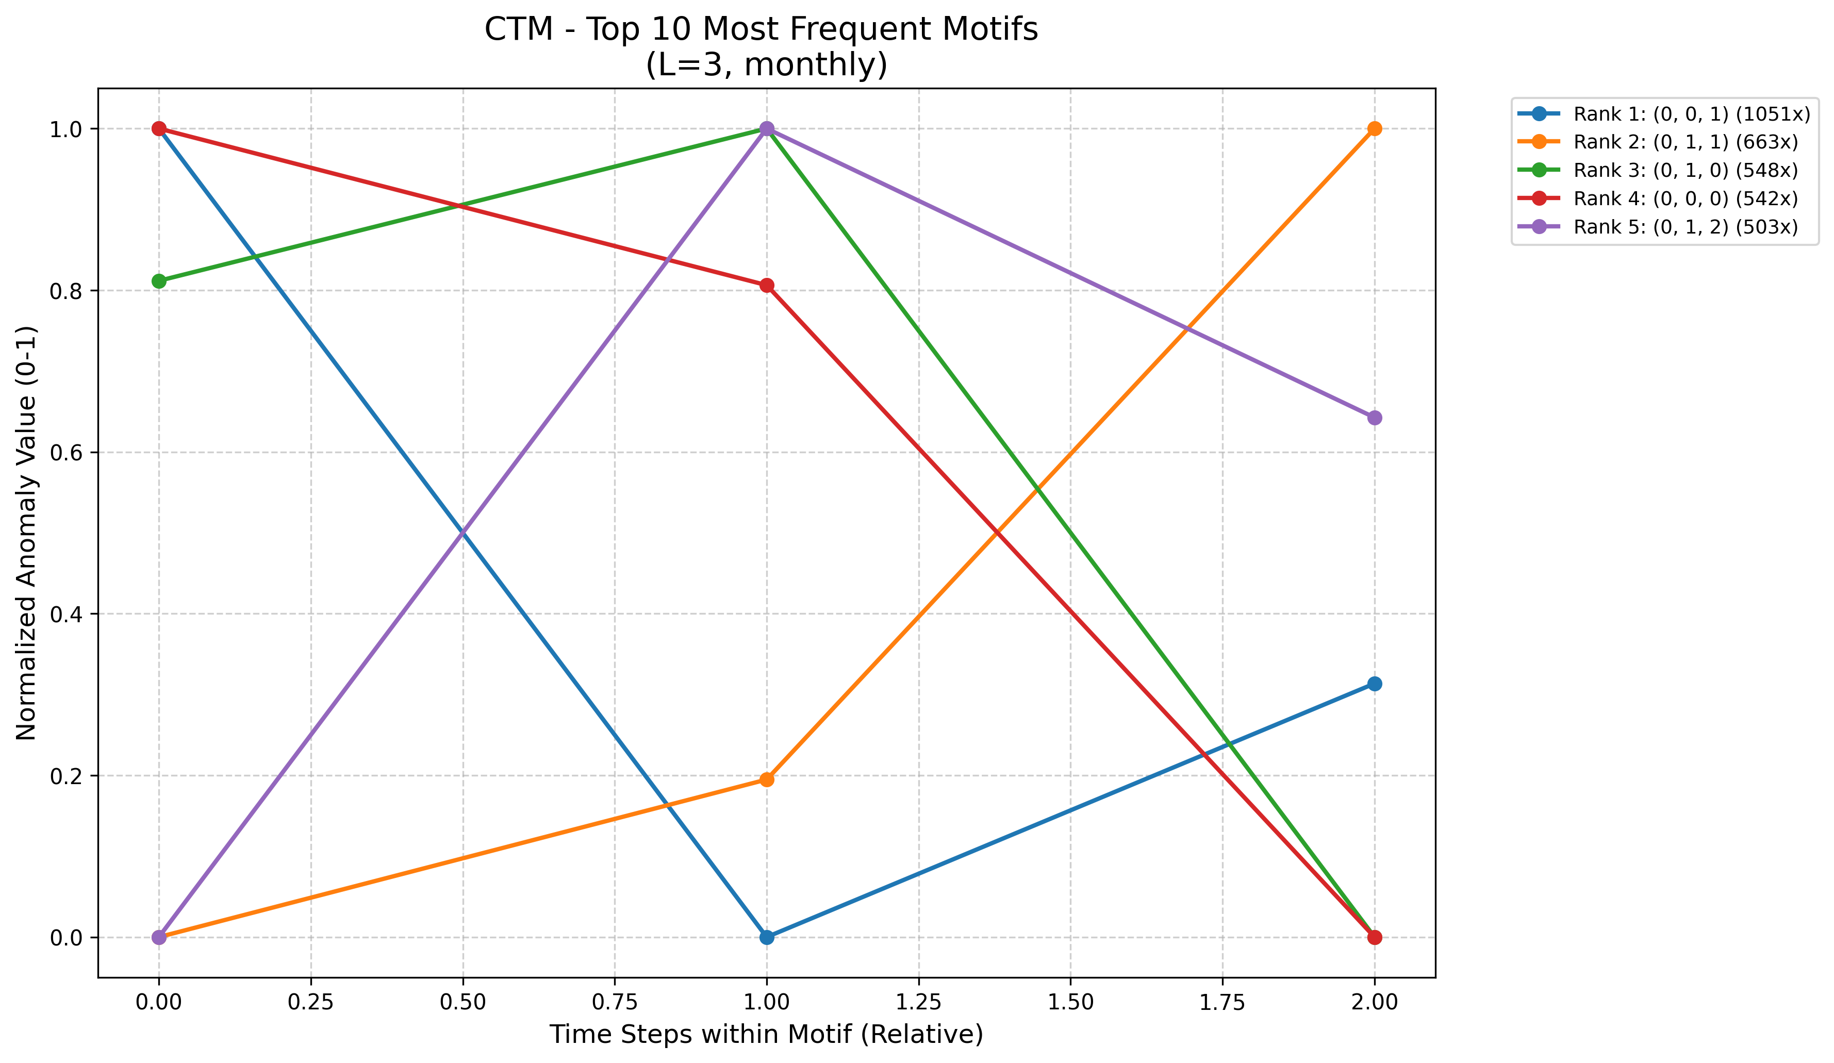

Slide 15
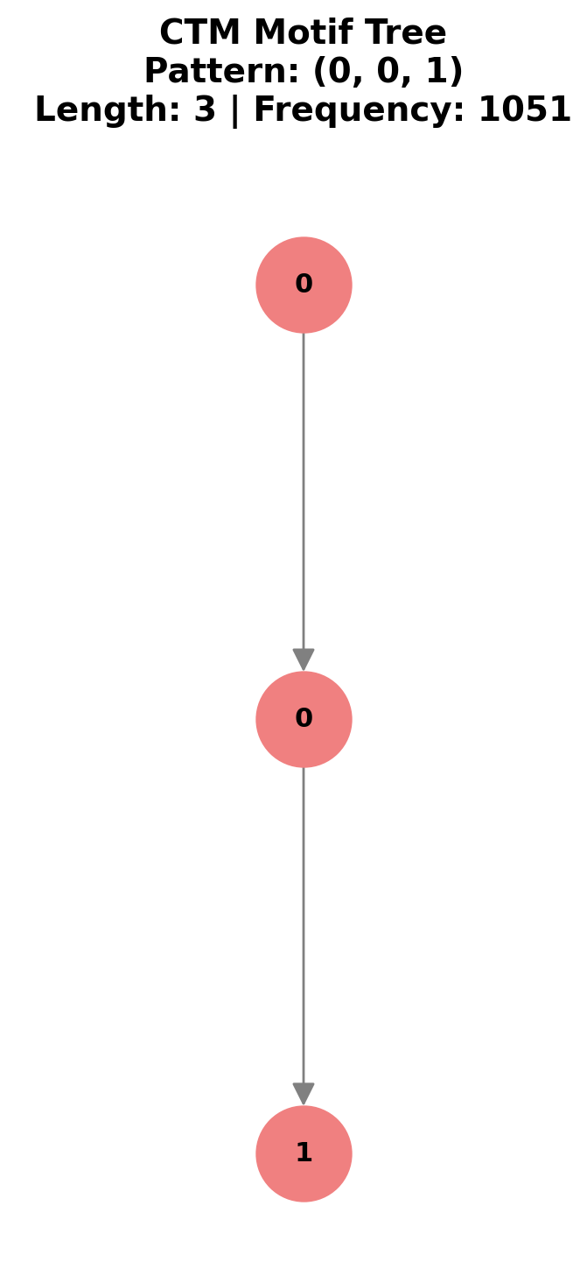

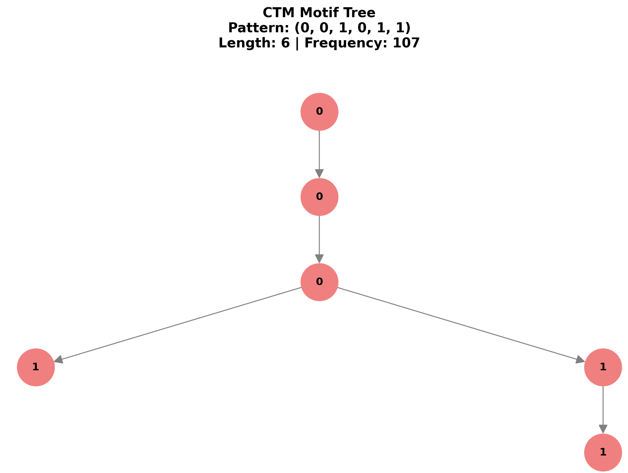

Slide 16


Conclusions:
The synthesis of OPM and CTM results provides a comprehensive understanding of global temperature anomalies. This combined approach allows us to identify robust and statistically significant patterns.
Robust Pattern Discovery
Climatic Insights
Algorithmic Success!
We can see that the motifs suggests that there’s global warming between the years 1750 – 2025 primarily at the later years
Identifying specific "shapes" in temperature shifts that correlate with known climate events.
Unlike exact matching, OPM and CTM found thousands of meaningful patterns by prioritizing structure over noise.

Slide 17

Task 2: Exact Repeating Sequences
Delving into the core of data integrity, this task focuses on identifying exact repeating sequences within a massive dataset. Understanding these patterns is crucial for validating data quality and revealing inherent structures.

Slide 18


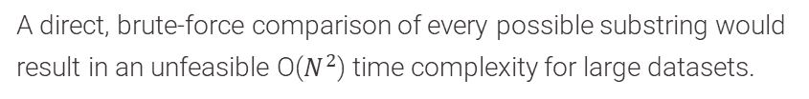
The Challenge: Scalable Substring Comparison
Massive String Dataset
Inefficient Naive Approach
The entire dataset is treated as a single, contiguous string of characters, demanding efficient processing methods.
A direct, brute-force comparison of every possible substring would result in an unfeasible O($N^{2}$) time complexity for large datasets.

Slide 19






The Solution: Advanced String Algorithms
LCP Array
The Longest Common Prefix (LCP) array complements the Suffix Array, storing the lengths of the longest common prefixes between adjacent suffixes.
Suffix Array
A powerful data structure used to quickly locate substrings within a larger text.
DC3 Algorithm
The Difference Cover 3 algorithm (DC3) is employed to construct Suffix Arrays and LCP Arrays efficiently, enabling fast pattern identification.

Slide 20

Longest Repeated Sequence Identified
Sequence Details
Length: 37 characters
Occurrences: Exactly twice in the dataset
Sequence: -0.3050.201-0.2840.192-0.3140.1531903
Interpretation
This 37-character sequence likely points to either two distinct historical periods with identical temperature anomalies and uncertainties (down to the third decimal point), or it indicates a specific data artifact within the dataset.

Slide 21

Most Frequent Pattern: "0."
Pattern Identified
The most frequent pattern discovered was "0.", appearing an astonishing 29,886 times throughout the dataset.
Contextual Interpretation
This high frequency directly reflects the inherent formatting of the data itself. The vast majority of numerical entries within the file represent decimal values that either start with 0 or -0, making "0." a ubiquitous prefix.

Slide 22



Maximal Repeats and Data Structure Insights
Definition: Maximal Repeats
"Maximal Repeats" are patterns that cannot be extended to the left or right without diminishing their repetition frequency, providing insights into the inherent structure of the data.
Top Results:
Length 6: ".0210."
Frequency: 124 times
Length 9: "-0.0180.0"
Frequency: 35 times
Length 37: The Longest Sequence
Frequency: 2 times
The exact string matching predominantly highlights the structure of data recording (e.g., decimal points, common prefixes like "-0.0") rather than revealing significant climate trends. This finding further justifies the necessity of Task 1 (Motif Mining) for unearthing meaningful climate patterns.
Notes:
Not Maximal: apple fr = 10 ppl : fr = 10 ppl is substring of apple and has the same fr it means that ppl never apeard on its own therefor ppl isn’t part of the ‘maximal’ reapeats in other words ppl isn’t maximal

Slide 23
משימות:
- לתת הערות לקוד יוני V
ללעשות את הדוח - יובל
סיים את המצגת
לבנות גרף עבור עשרת המוטיבים הגדולים ביותר של CTM,OPM. -shahar
CTM OPMגרף BAR שך כל המוטיפים מאורכים שונים- yoni V
עץ של איך נראה העץ של כל אורך אפשרי CTm TOP עצים משמעותיים shahar
להוסיף TASK 2 yoniV
להרחיב את הגרף yoni V

